Slide 1
Lead-Score Case Study
Presented by
Shalini Yaramada

Slide 2

Problem Statement
X Education wishes to identify the most potential leads, also known as ‘Hot Leads’, the leads that are most likely to convert into paying customers.

Slide 3
Data Explanation
With 37 variables explaining of professional which leads to conversion rate of a customer with 9240 customers
Many of the categorical variables have a level called 'Select' which replaced with a null value, this is the one which actually pops when the user didn’t select any of the below options
No Duplication of data
Target variable : 38% of them got converted as lead, 38 percent is a class which is moderately balanced class, Accuracy measure is enough for this kind of data, But lets see its ROC curve as well

Slide 4
Data Cleaning
There are nulls in data, which need to be cleaned
Features having high nulls
How did you hear about X Education 78.46
Lead Profile 74.19
Lead Quality 51.59
Asymmetrique Profile Score 45.65
Asymmetrique Activity Score 45.65
Asymmetrique Profile Index 45.65
Asymmetrique Activity Index 45.65
City 39.71
Specialization 36.58
Tags 36.29
What matters most to you in
choosing a course 29.32
What is your current occupation 29.11
Country 26.63
The Variables with high null values are in left side,
which have more than or nearly to 30% of null share, So choose to drop that columns
Columns with low nulls
Replaced null values of numeric columns with 0
Removed the rows which have nulls for categorical columns
TotalVisits 1.48
Page Views Per Visit 1.48
Last Activity 1.11
Lead Source 0.39

Slide 5
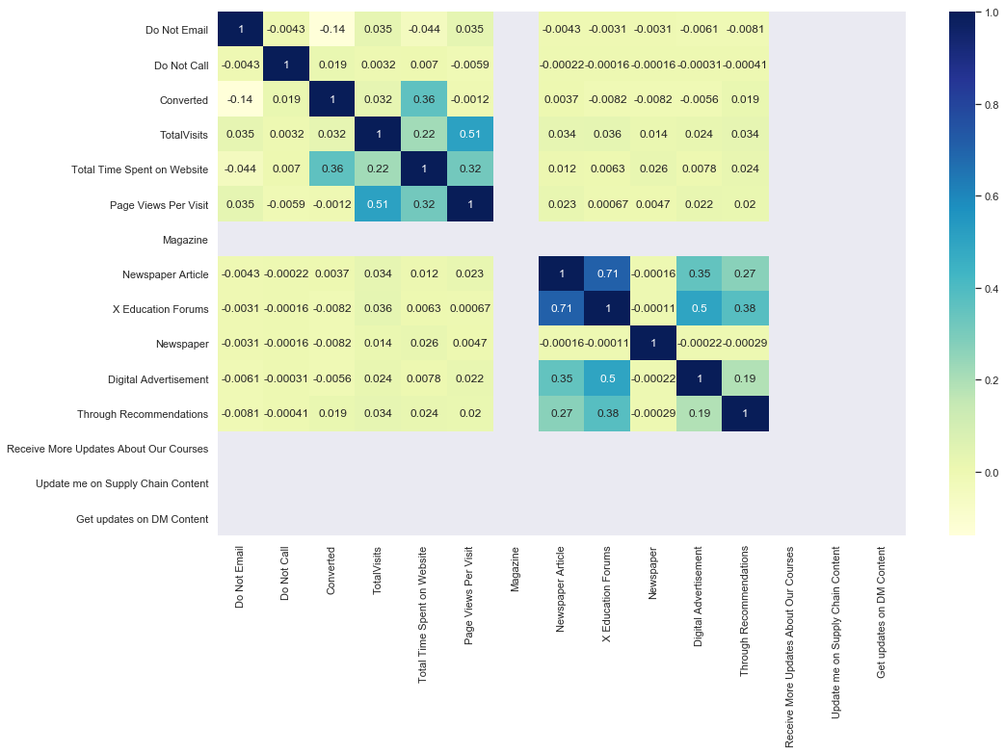
Dummy variable creation and correlations
After cleaning we are left with 19 columns
Dummy Variables
From 19 columns, category columns and numeric columns are separated and created dummies for categorical columns
After Dummy variable creation, we left with 56 columns
As shown in correlation matrix
There is not enough information to show correlations for some of columns(which some columns are only 0’s or 1 ‘s)
But we are leaving it for our model to decide which columns are significant and which are not significant
Not much correlations as well
Lets go with RFE rather than PCA as data is not much correlated

Slide 6
Model Building
Splitting Data
Split data to train and test sets, train set to be 80% of whole data to train the model and test 20% to evaluate the train results
Scaling
Train and test sets are separately scaled to minimize information leakage to the validation or test set
#Scaled the data using MinMax Scaler, as the dataset contains most of the categorical columns with 0’s ad 1’s and also this a classification problem
The MinMaxScaler transforms features by scaling each feature to a given range

Slide 7
RFE and Models
Model 1
We feed RFE with 56 columns to choose from and get 15 columns which are significant, as we know there are very few columns which are significant from correlation matrix and initial data
Model 2
From 15 variables, we have removed 2 insignificant variables which are having high p-values
Model 3
From 13 variables, we removed 2 more columns,1 with high VIF and other with moderate p-value which is insignificant
Finally we left with 11 columns, which are quiet a good a number to describe target variable

Slide 8
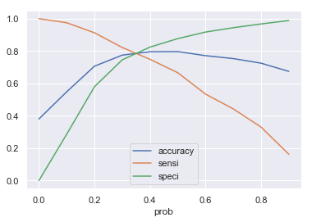
Train set Results and Tuning
Optimal Cut-off point:
As shown in the plot the intersection of accuracy sensitivity and specificity is at 0.35
From the predictions of logistic regression model
For a cut-off of 0.5 (randomly chosen)
Accuracy : 0.796484
Confusion Matrix:
[[3955 557]
[ 925 1845]]
Sensitivity 0.66606
Specificity 0.87655

Slide 9
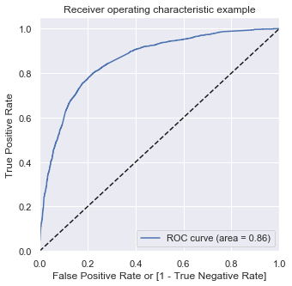
Tuning to 80%
The CEO, in particular, has given a ballpark of the target lead conversion rate to be around 80%
For The conversion rate to be 80. i.e., Sensitivity to be 80%
Cut-off is 0.33
Accuracy: 0.78426
Confusion Matrix:
[[3486 1026]
[ 545 2225]]
Sensitivity 0.80324
Specificity 0.77260
ROC curve showing 86 % of area under curve which shows it’s a good model

Slide 10
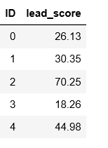
Test set results/Lead score
For a optimal cut-off of 0.35 for a random test set
Accuracy:
0.7226
Confusion Matrix
[[722, 417],
[ 88, 594]]
Sensitivity 0.8709
Specificity 0.6338
As this is random test set, the test results are not good enough compared to train set.
May be by use of cross validations we may get good results with test set too
Lead Score:
Lead score has been calculated with probabilities multiplied by 100,
following is first 5 results

